Slide 1
Fashion Classification and Detection Using Convolutional Neural Networks
Archit Arora
May 8, 2018

Slide 2
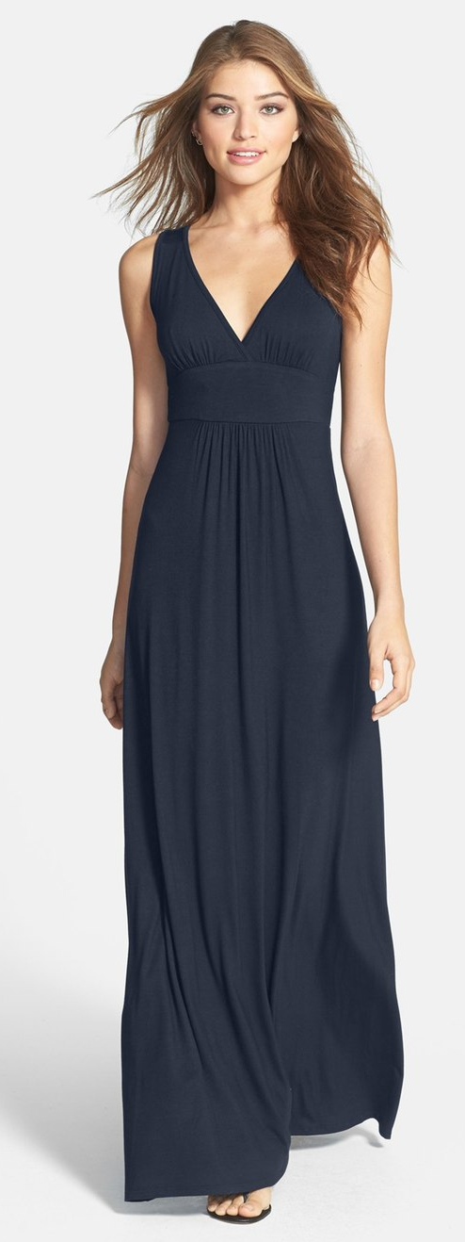
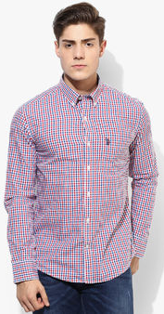
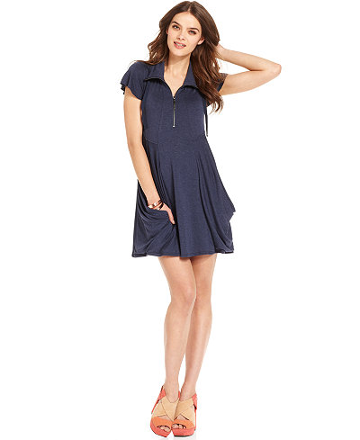
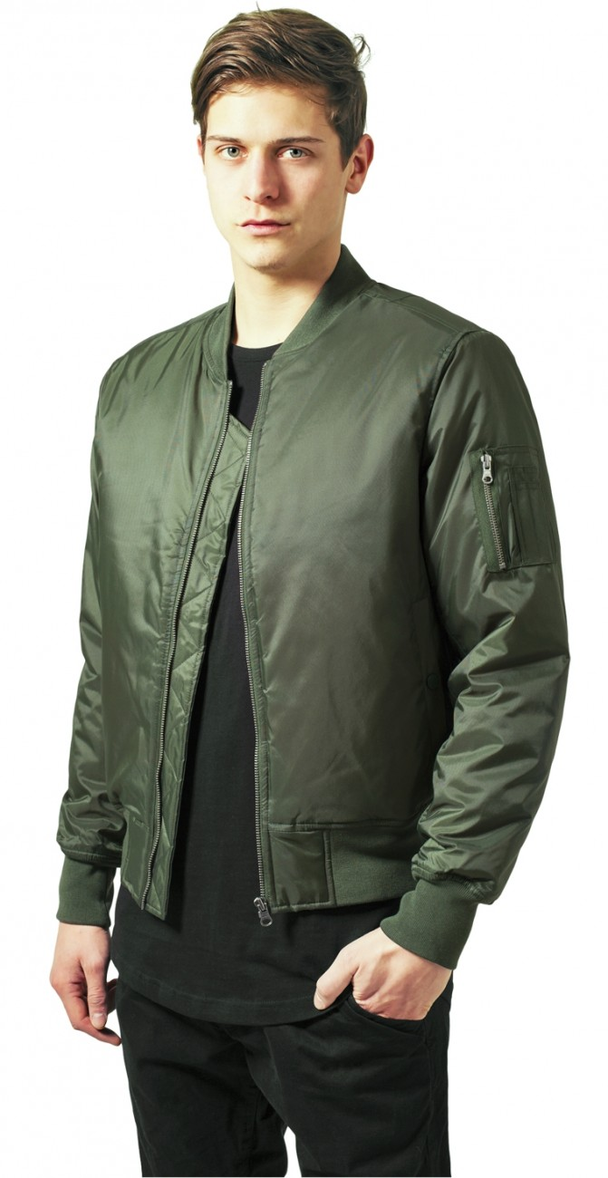
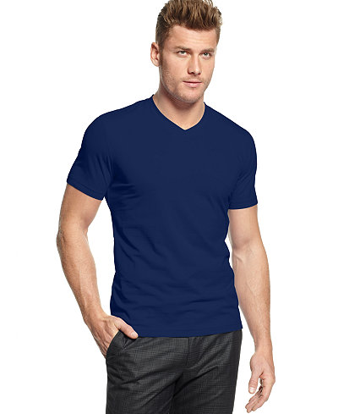
Fashion Classification Problem
Given an image, identify the apparel a particular person is wearing

Slide 3
Applications
Targeted ads
Product recommendations
Identification of suspects through CCTV footage
Brand adoption trends for clothing companies

Slide 4
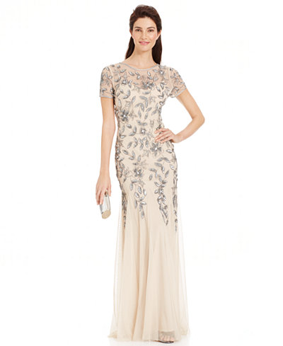
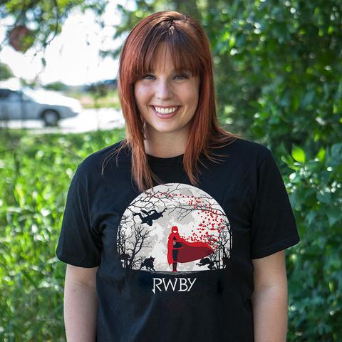
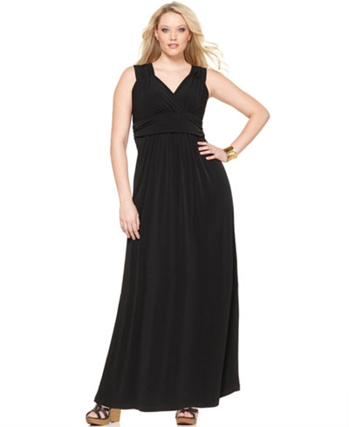

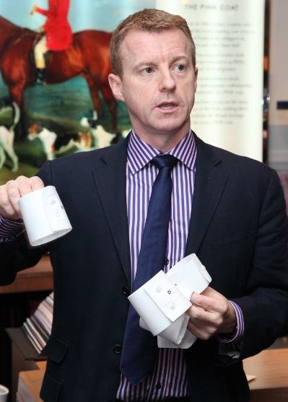

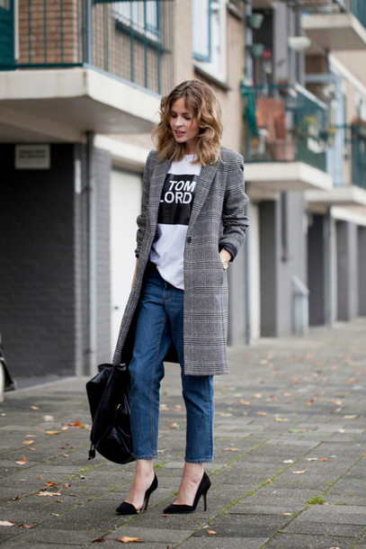
Challenges
Intra-class variation
Viewpoint and locational variation
Scale variation
Background clutter

Slide 5
Overview of fashion classification process
Data collection
Data augmentation
Learning from data
Image classification

Slide 6
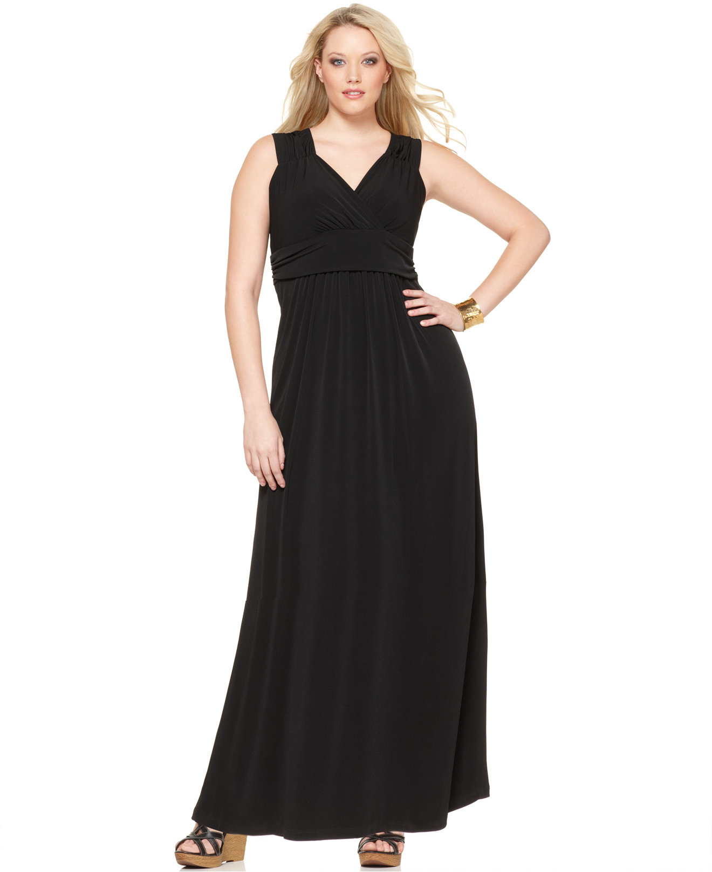
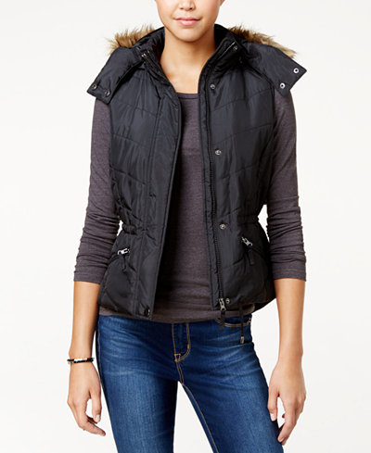
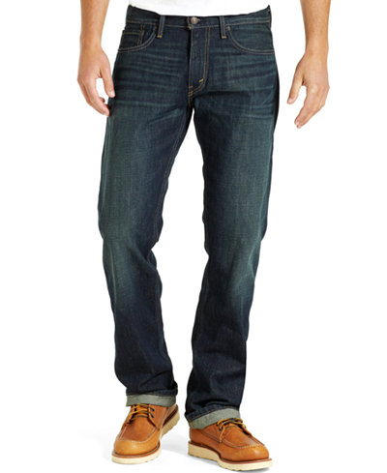
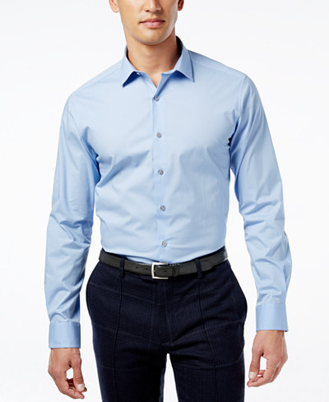
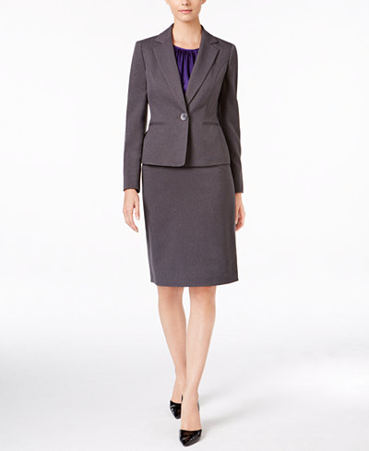
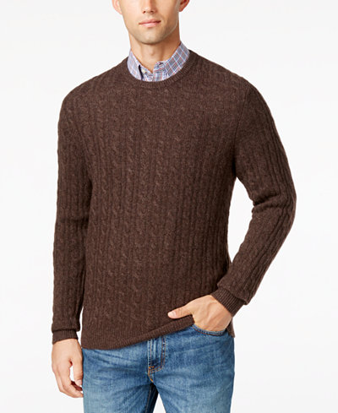
Data collection
Used Scrapy tool to search and crawl Macy’s website
Generated a labelled data set of around 3500 images belonging to these categories
14 Fashion Categories
Jacket | Long-dress | Polo shirts | Suit | Short-dress
T-shirt | Sweater | Trousers | Shoes | Robe
Shirt | Jeans | Swimsuit | Shorts

Slide 7
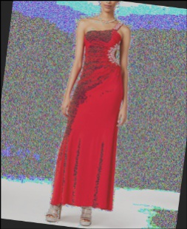
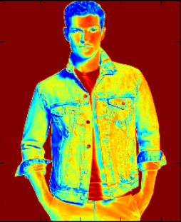
Data augmentation/preprocessing
Implemented to improve robustness of the classifier
Effects introduced to account for deviations from training data set:
Background noise (white background converted to noisy background)
Rotation
Contrast change
Crop to tackle scale variances
Resizing to tackle resolution variances
Image normalization
(subtracting the mean from
respective RGB channels)
scipy, scikit-image were used to add the
above effects

Slide 8
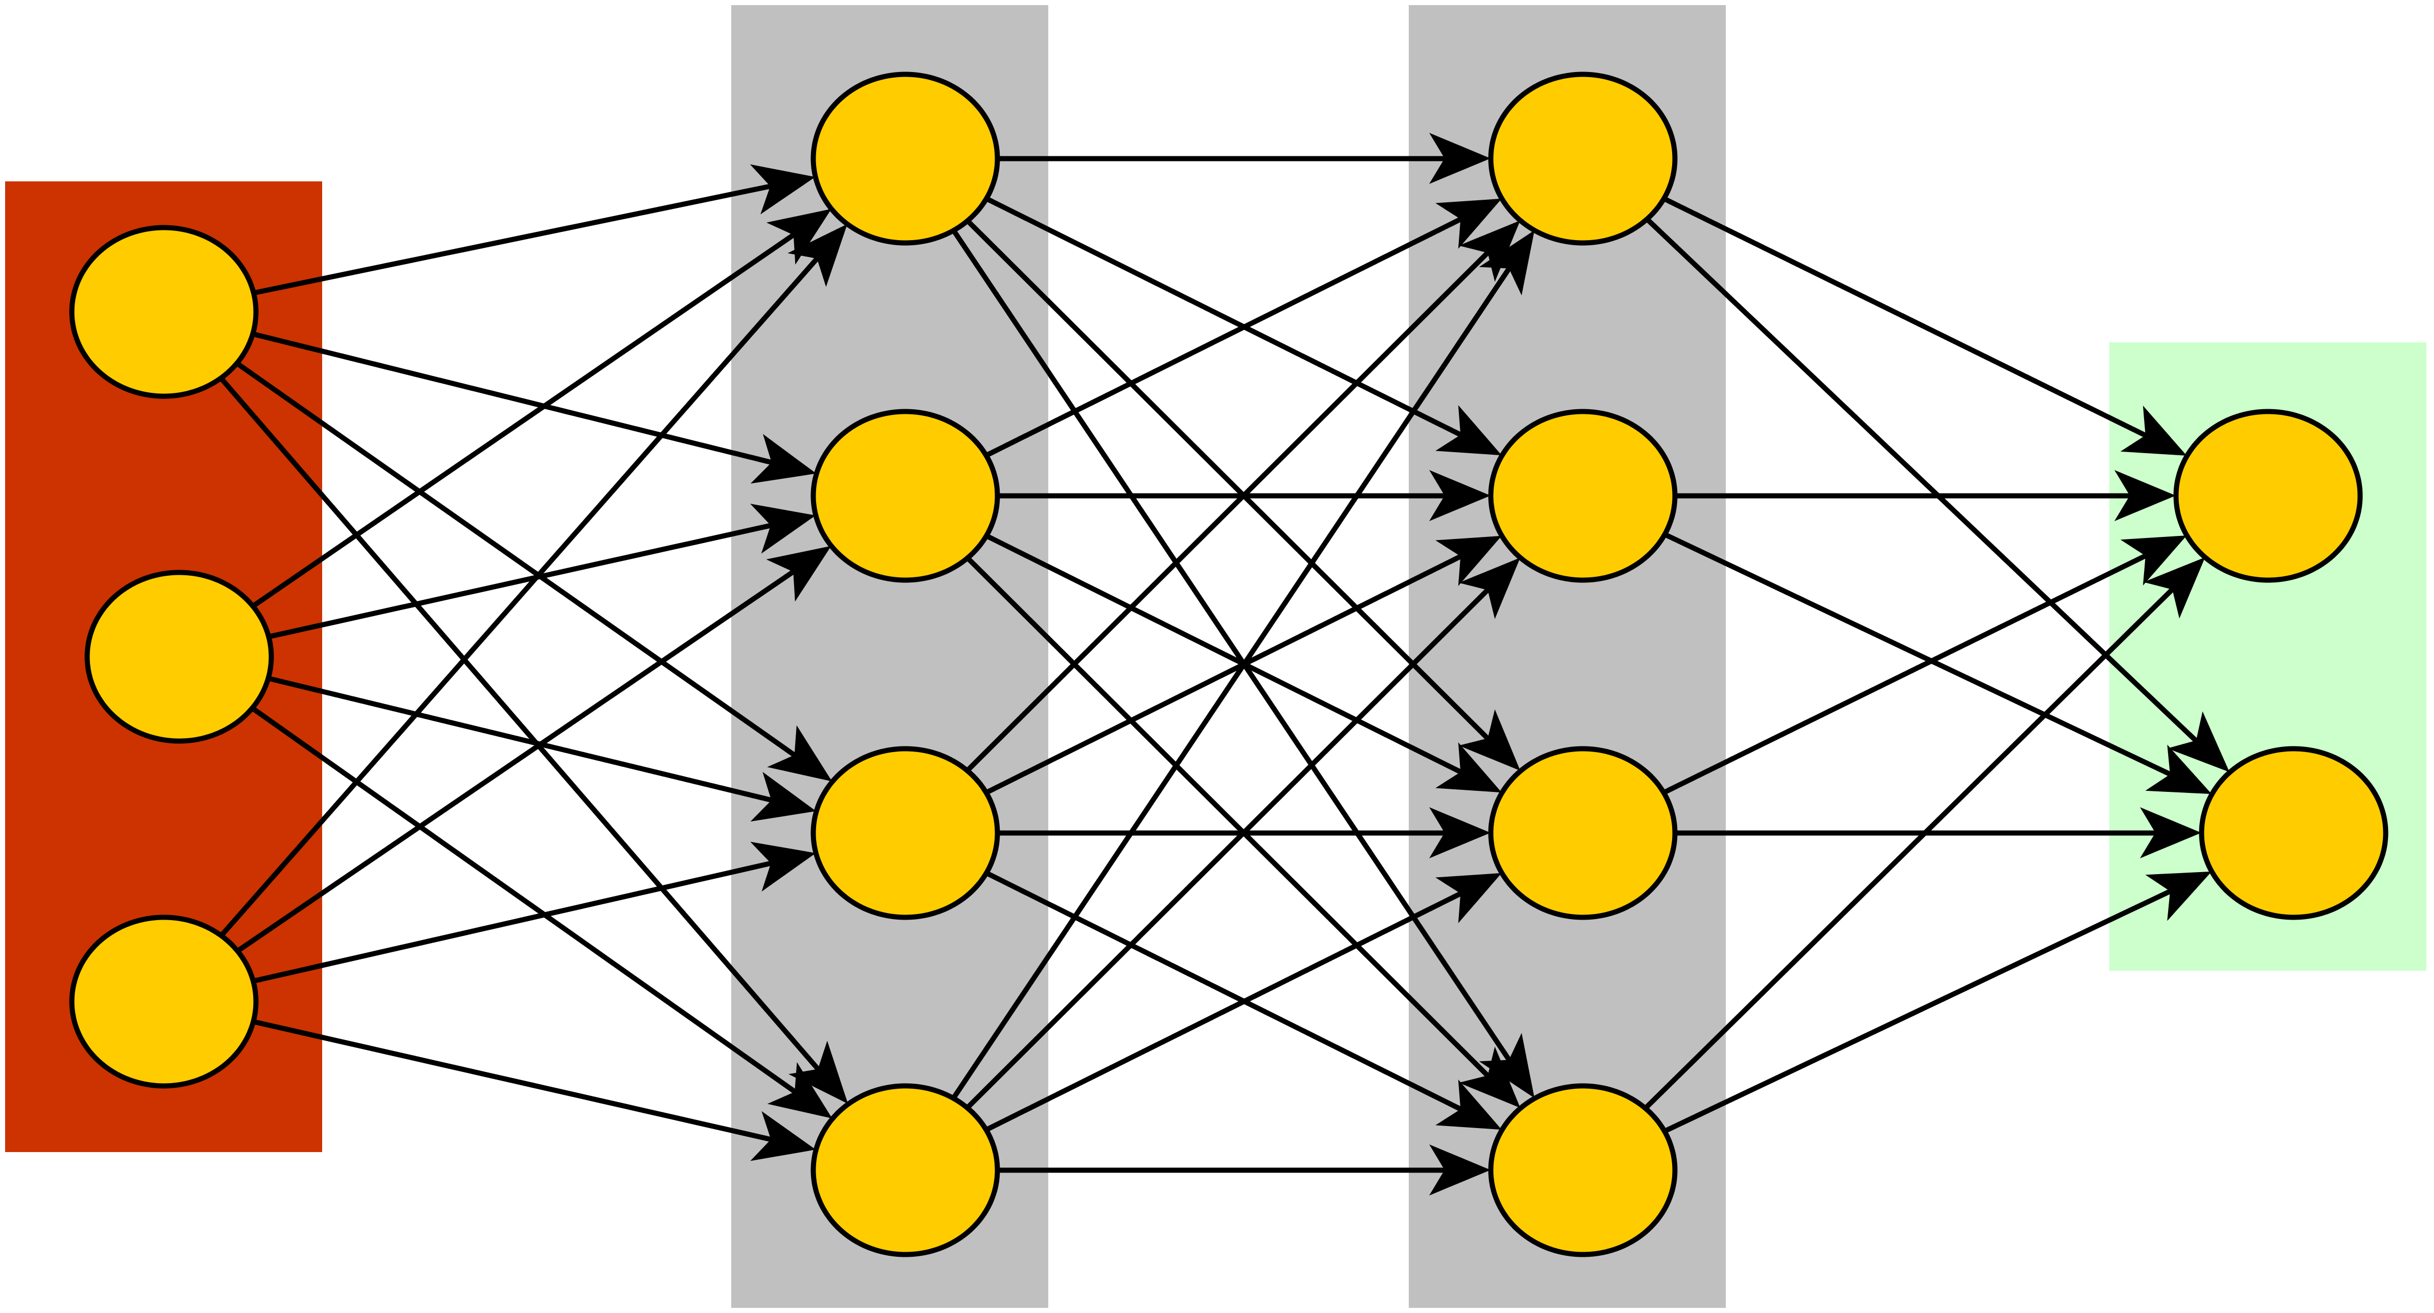
Learning from data: Multi-layer perceptron
Output Layer
Input Layer
(pixels of each image)
Hidden Layer-1
Hidden Layer-2

Slide 9
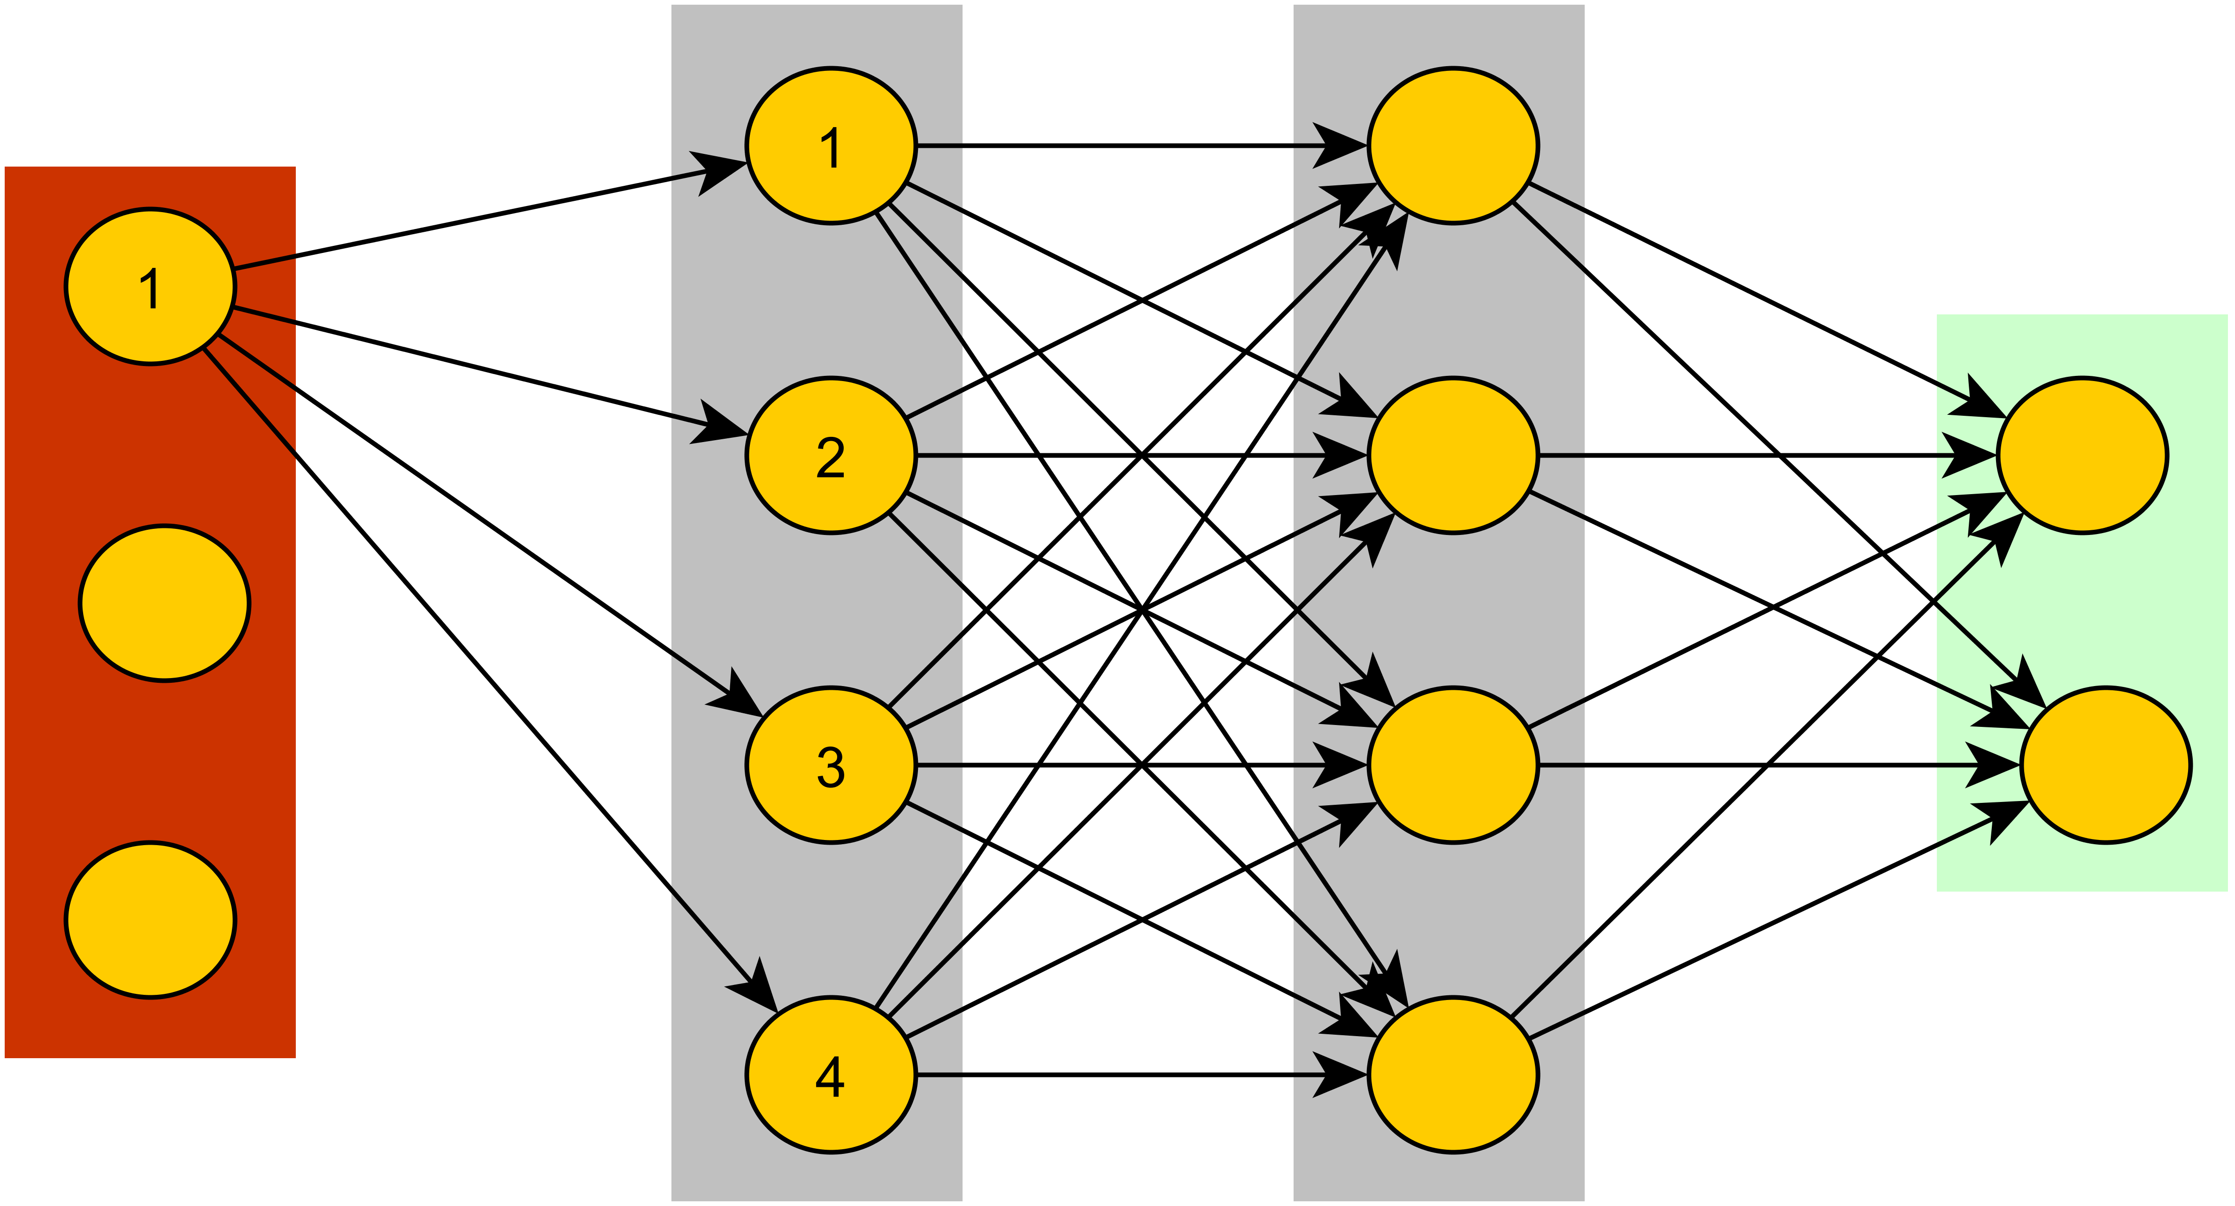
Learning from data: Multi-layer perceptron
w11
w12
w13
w14
Output Layer
Input Layer
(pixels of each image)
Hidden Layer-1
Hidden Layer-2

Slide 10
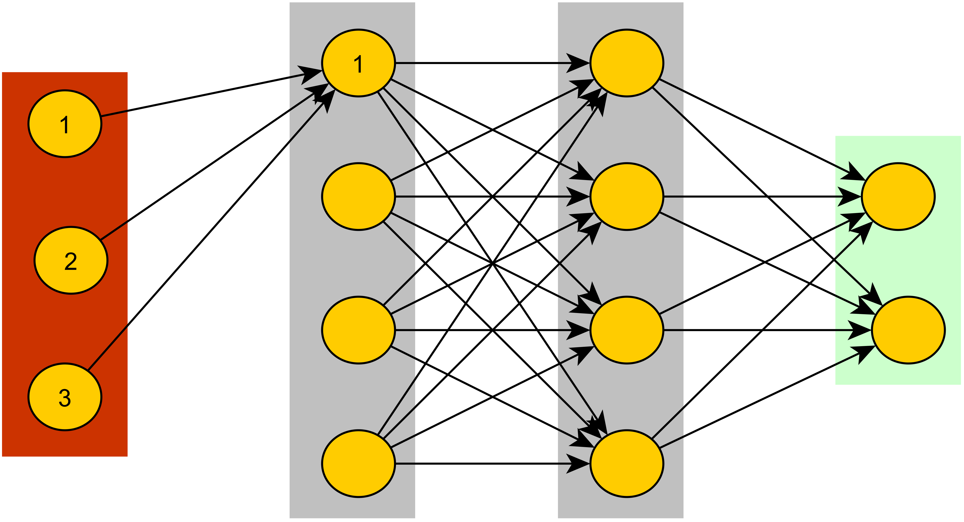
Learning from data: Multi-layer perceptron
w11
w11
w21
w12
w13
w31
w14
Output Layer
Input Layer
Hidden Layer-1
Hidden Layer-2
Non-linear activation function to identify complex data patterns.
Eg: f(x) = max(0,x) (ReLu)

Slide 11
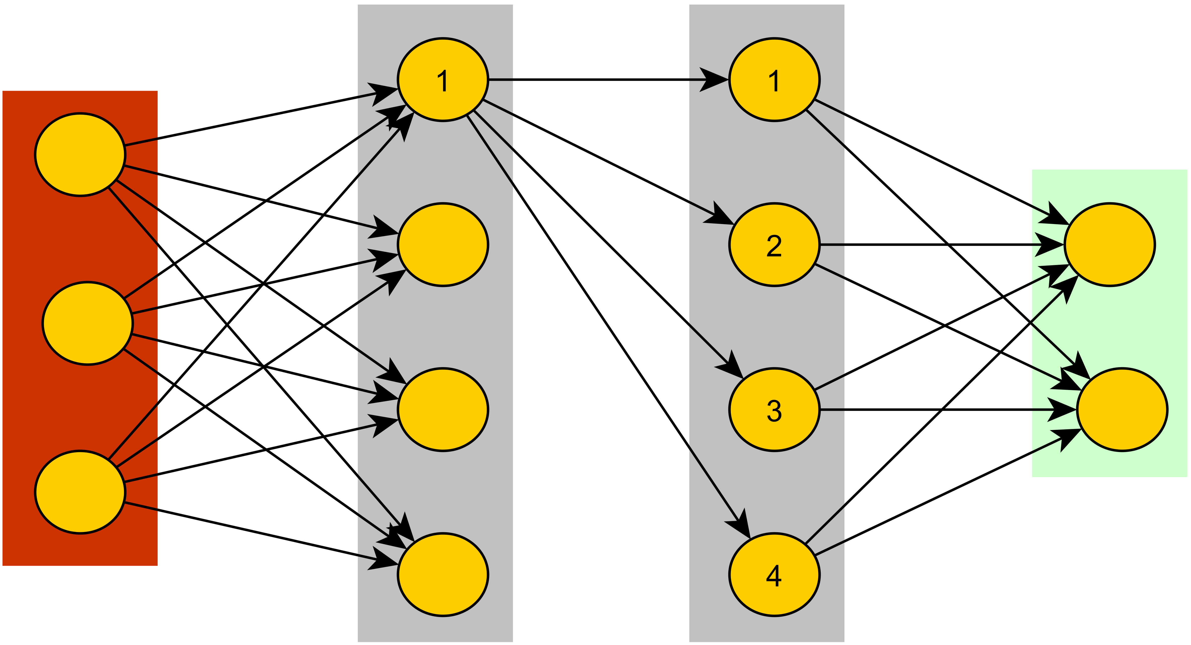
Learning from data: Multi-layer perceptron
w11
w11
w11
w12
w21
w12
w13
w13
w31
w14
w14
Output Layer
Input Layer
Hidden Layer-1
Hidden Layer-2

Slide 12
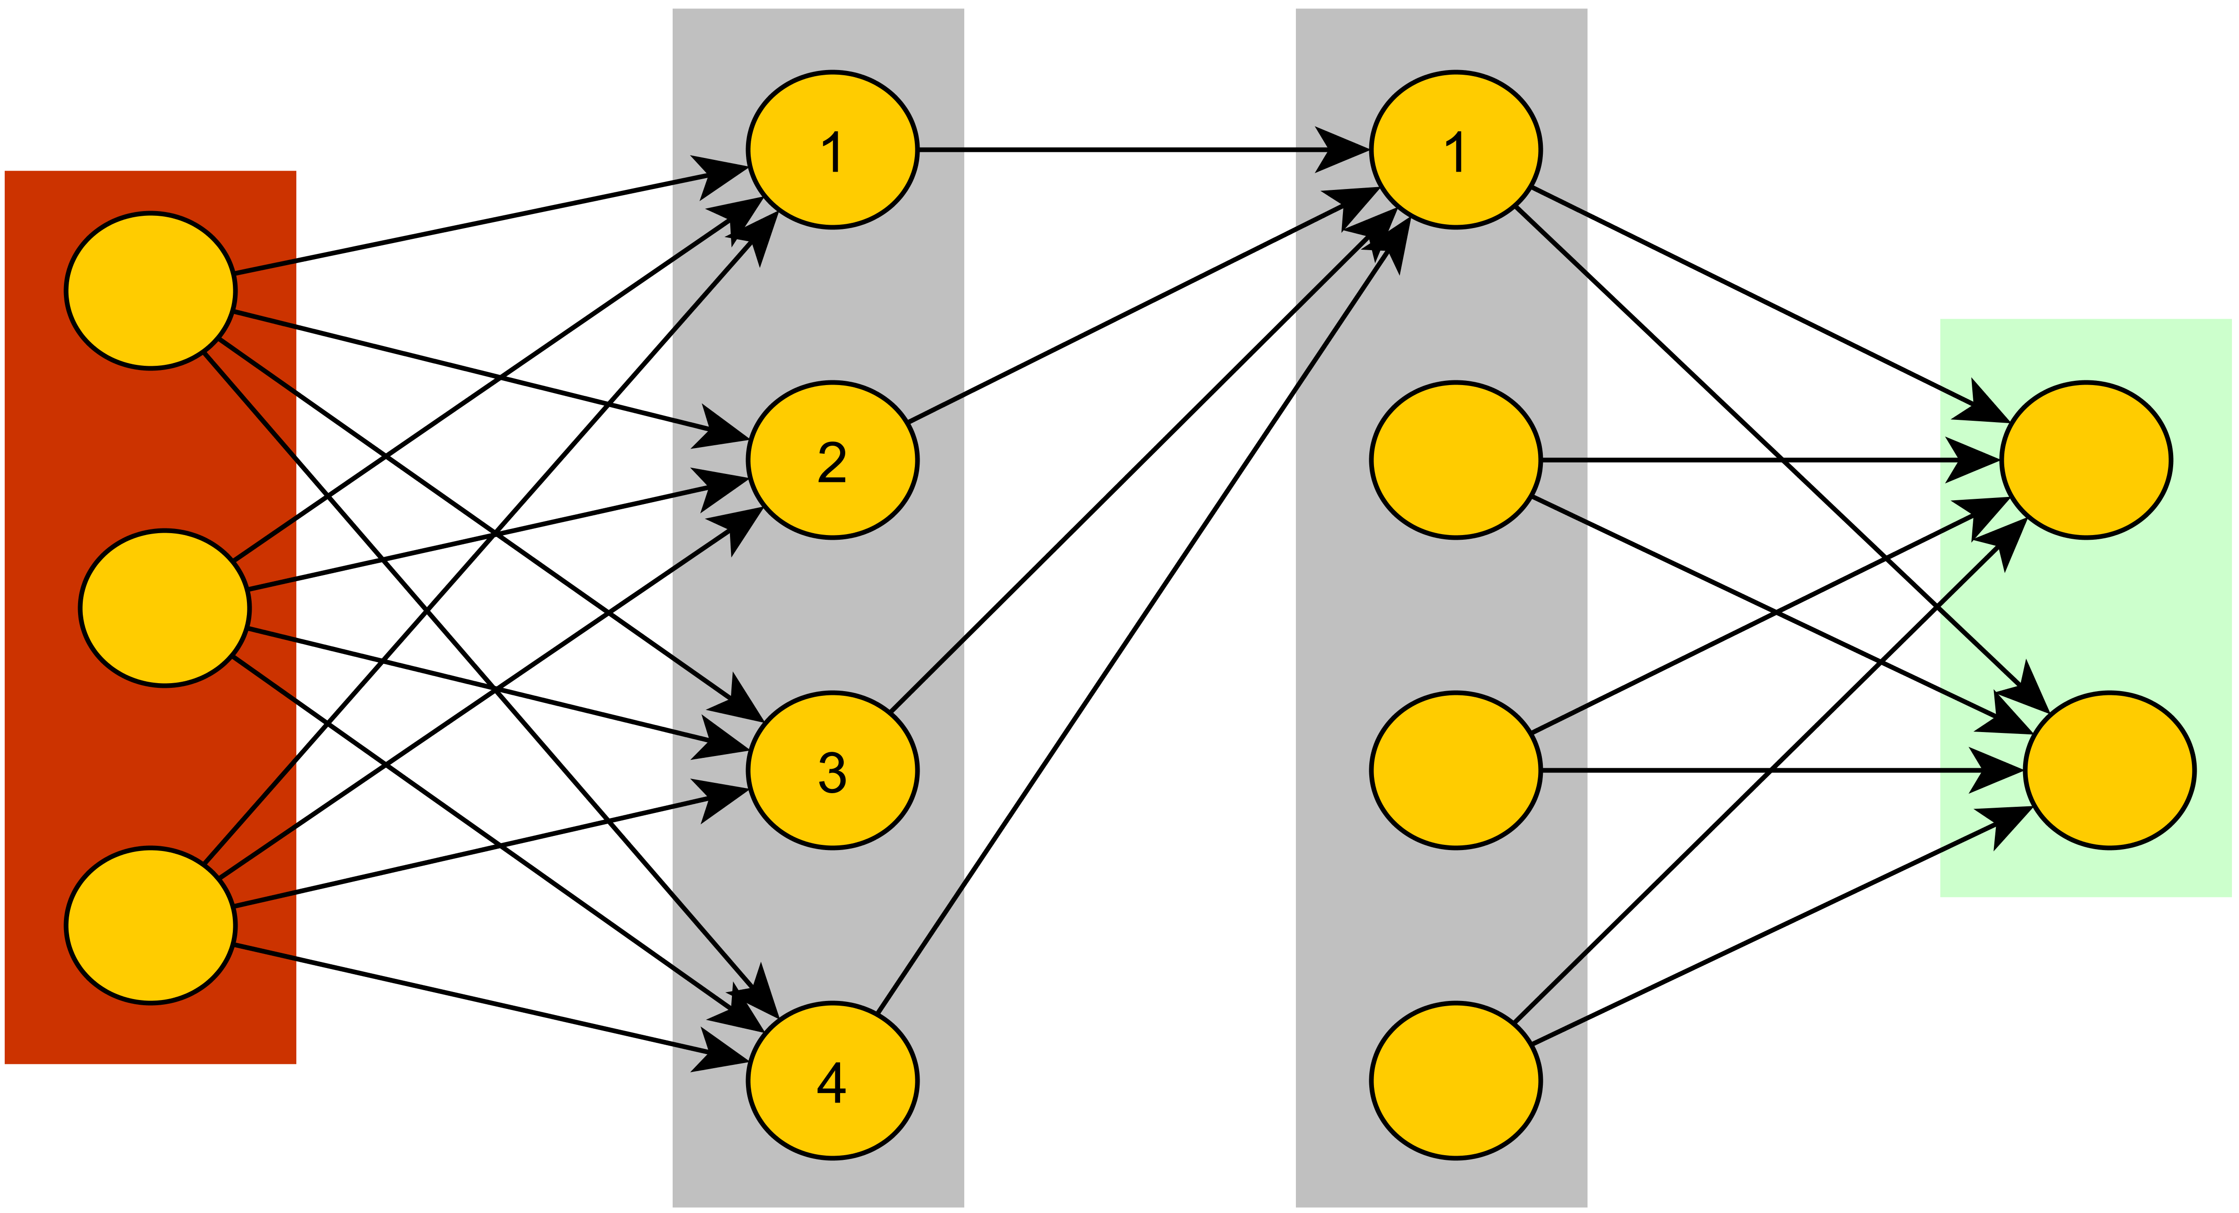
Learning from data: Multi-layer perceptron
w11
w11
w11
w11
w12
w12
w21
w12
w13
w13
w13
w31
w14
w14
w14
Output Layer
Input Layer
Hidden Layer-1
Hidden Layer-2 (Non-linear activation function)

Slide 13
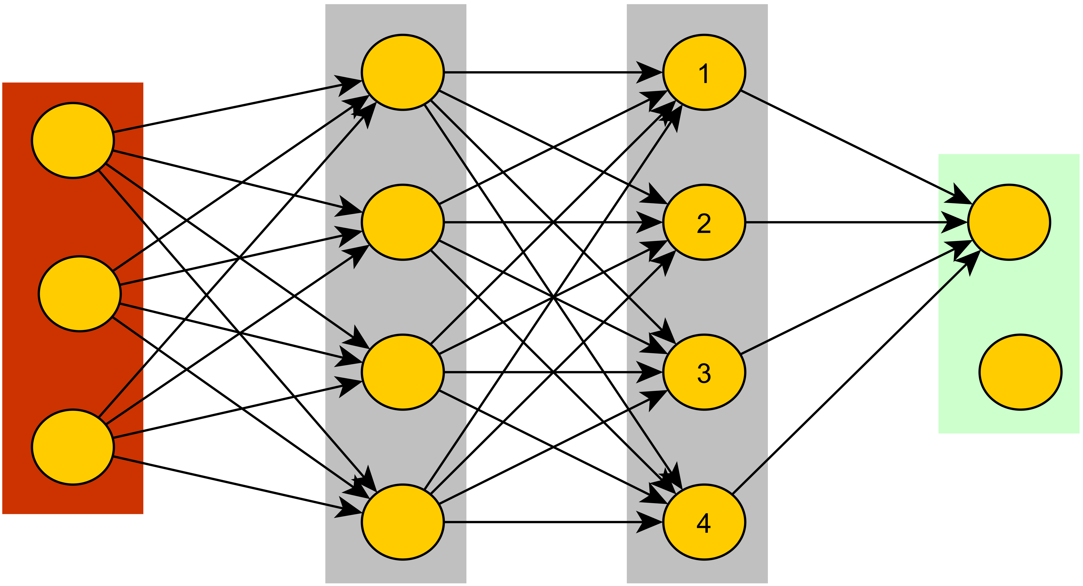

Learning from data: Multi-layer perceptron
w11
w11
w11
w11
w12
w12
w11
w21
w12
w13
w13
w12
w13
w31
w14
w13
w14
w14
w14
Output Layer
Input Layer
Softmax function to assign probabilities to classes.
Hidden Layer-1
Hidden Layer-2

Slide 14
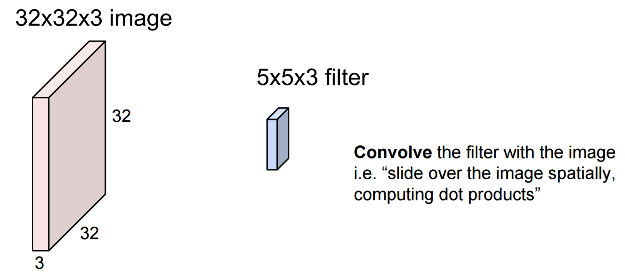
Learning from data: Convolutional Neural Networks (CNN)
Main Issue: Multi-Layer Perceptron does not scale well to image data. Use CNNs!
Image input as volume
[Slides taken from Lec-7 CS231N Convolutional Neural Networks for Computer Vision]

Slide 15
Learning from data: Convolutional Neural Networks (CNN)
Depth of filter is the same the depth of input volume
[Slides taken from Lec-7 CS231N Convolutional Neural Networks for Computer Vision]

Slide 16
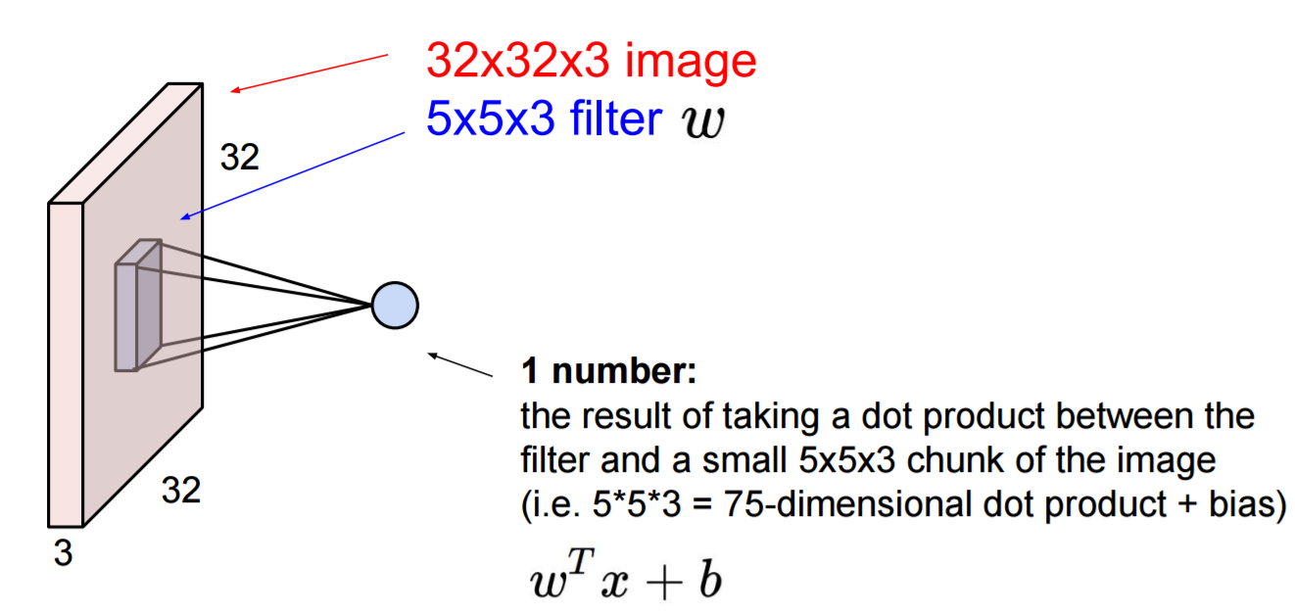
Learning from data: Convolutional Neural Networks (CNN)
Evaluates image similarity with filter template
[Slides taken from Lec-7 CS231N Convolutional Neural Networks for Computer Vision]

Slide 17
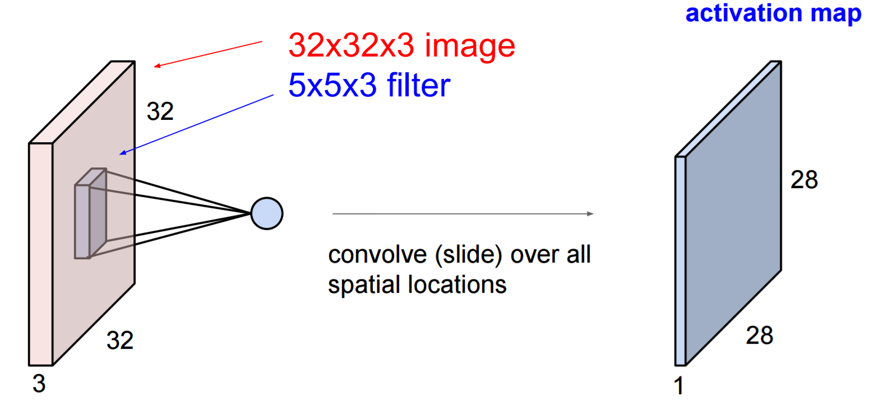
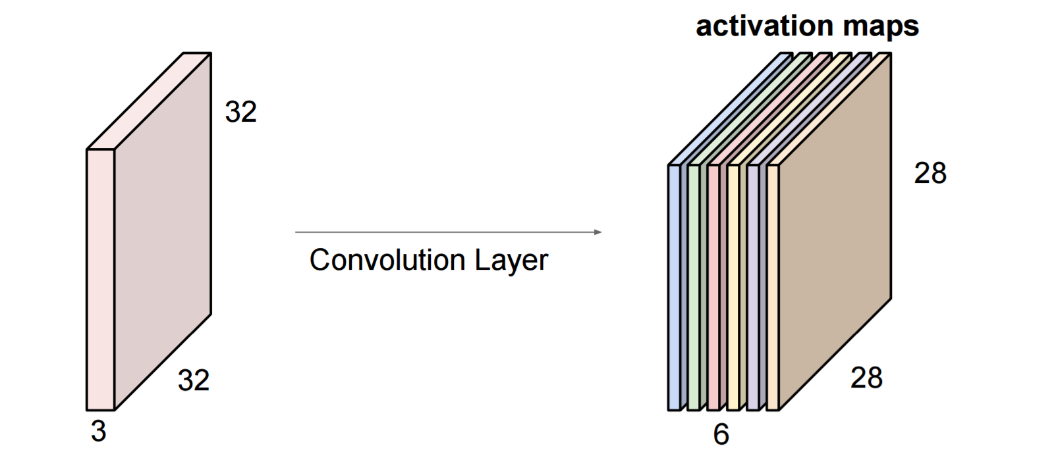
Learning from data: Convolutional Neural Networks (CNN)
Non-linear activation function like
ReLu
[Slides taken from Lec-7 CS231N Convolutional Neural Networks for Computer Vision]

Slide 18
Learning from data: Convolutional Neural Networks (CNN)
[Slides taken from Lec-7 CS231N Convolutional Neural Networks for Computer Vision]

Slide 19
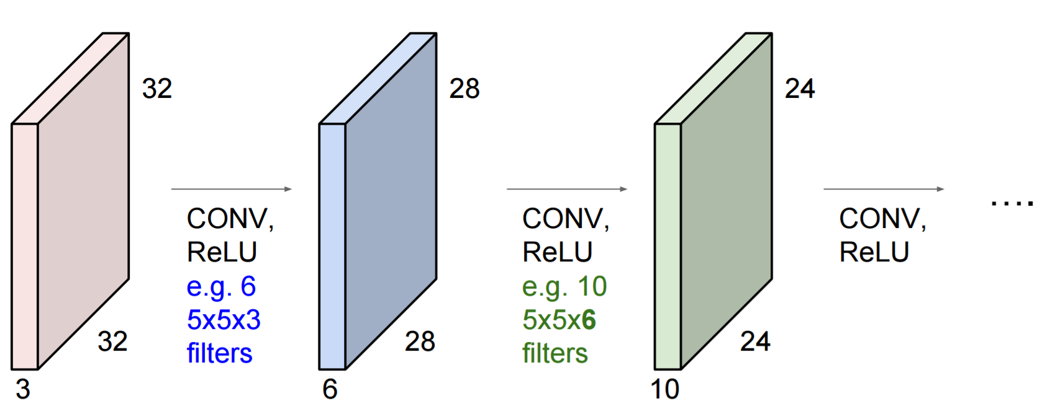
Learning from data: Convolutional Neural Networks (CNN)
[Slides taken from Lec-7 CS231N Convolutional Neural Networks for Computer Vision]

Slide 20
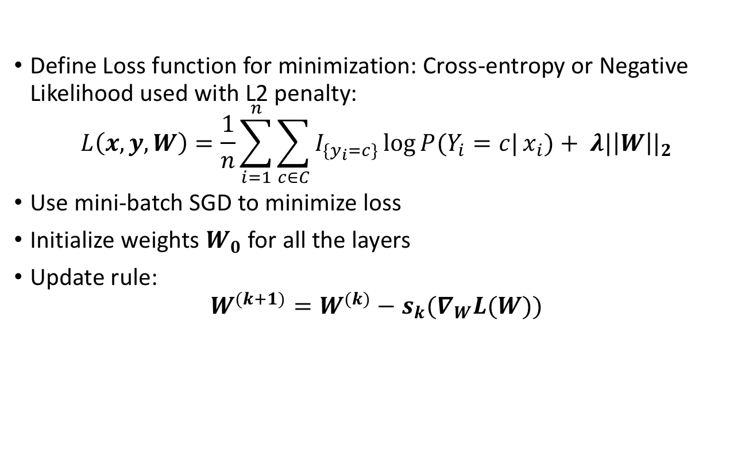
Steps involved in Training Data
Define Loss function for minimization: Cross-entropy or Negative Likelihood used with L2 penalty:
$$L\left(x,y,W\right)=\frac{1}{n}\sum_{i=1}^{n}{\sum_{c∈C}{I_{\{y_{i}=c\}}}\log{P(Y_{i}=c|}}x_{i})+ λ{|\left|W\right||}_{2}$$
Use mini-batch SGD to minimize loss
Initialize weights $W_{0}$for all the layers
Update rule:
$$W^{(k+1)}=W^{(k)}−s_{k}(∇_{W}L(W))$$
This gradient is calculated using Backward Propagation

Slide 21
Using Pre-trained models
In practice, training CNNs from scratch is hardly used due to computational considerations
Instead, pre-trained models trained on other dataset are used
Main idea: Low level features are common to all image classification problems
For our project we used VGG-16 model trained for ImageNet classification challenge on 1000 categories

Slide 22
VGG-16 Architecture
Input: 224x224 size images with 3 channels
Convolutional (224x224x64)
Convolutional (224x224x64)
Max Pool (112x112x64)
Convolutional (112x112x128)
Convolutional (112x112x128)
Max Pool (56x56x128)
Convolutional (56x56x256)
Convolutional (56x56x256)
Convolutional (56x56x256)
Max Pool (28x28x256)
Convolutional (28x28x512)
Convolutional (28x28x512)
Convolutional (28x28x512)
Max Pool (14x14x512)
Convolutional (14x14x512)
Convolutional (14x14x512)
Convolutional (14x14x512)
Max Pool (7x7x512)
Fully Connected (1x1x4096)
Fully Connected (1x1x4096)
Fully Connected (1x1x1000)
Soft-max (1x1x1000)
Reduces spatial dimensions

Slide 23
Implementation: Modified VGG-16
Input: 224x224 size images with 3 channels
Convolutional (224x224x64)
Convolutional (224x224x64)
Max Pool (112x112x64)
Convolutional (112x112x128)
Convolutional (112x112x128)
Max Pool (56x56x128)
Convolutional (56x56x256)
Convolutional (56x56x256)
Convolutional (56x56x256)
Max Pool (28x28x256)
Convolutional (28x28x512)
Convolutional (28x28x512)
Convolutional (28x28x512)
Max Pool (14x14x512)
Convolutional (14x14x512)
Convolutional (14x14x512)
Convolutional (14x14x512)
Max Pool (7x7x512)
Fully Connected (1x1x4096)
Fully Connected (1x1x4096)
Fully Connected (1x1x1000)
Soft-max (1x1x1000)
Treat the previous layers (weights) as fixed since they identify low level features and tune the parameters on the last 3 fully connected layers

Slide 24
Results using Macy’s data
Cross-entropy loss versus number of iterations
Initially, results were observed using the train-test split within Macy’s data (without data augmentation)
~92% accuracy was achieved

Slide 25
Results using Macy’s data
Label | Category
0 | Jacket
1 | T-Shirt
2 | Shirt
3 | Jeans
4 | Long-dress
5 | Shoes
6 | Trousers
7 | Polo-shirts
8 | Robe
9 | Short-dress
10 | Shorts
11 | Suit
12 | Sweater
13 | Swimsuit

Slide 26
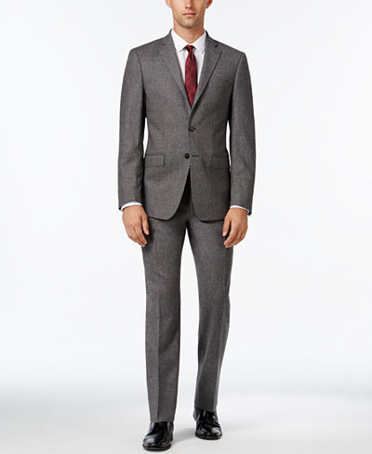
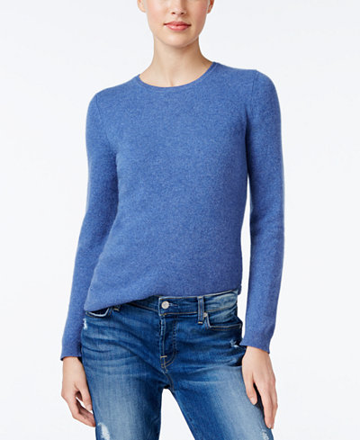
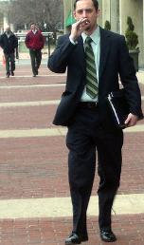
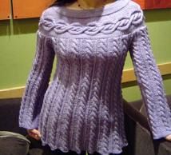
Results using Macy’s data
Training Data
Test Data
Results were exceptionally bad (~20% accuracy) when using the same training data to predict a test data of real life examples from Google Images
Hence, there was a need for data augmentation
Notes:
No Background noise, not centered

Slide 27
Results for test data after data augmentation
Cross-entropy loss versus number of iterations
The test data consisted of around 60 images from Google Images comprising of real world photos
~71% accuracy was achieved

Slide 28
Results for test data after data augmentation
Label | Category
0 | Jacket
1 | T-Shirt
2 | Shirt
3 | Jeans
4 | Long-dress
5 | Shoes
6 | Trousers
7 | Polo-shirts
8 | Robe
9 | Short-dress
10 | Shorts
11 | Suit
12 | Sweater
13 | Swimsuit

Slide 29
THANK YOU

Slide 30
Categories used for labelling
Label | Category
0 | Jacket
1 | T-Shirt
2 | Shirt
3 | Jeans
4 | Long-dress
5 | Shoes
6 | Trousers
7 | Polo-shirts
8 | Robe
9 | Short-dress
10 | Shorts
11 | Suit
12 | Sweater
13 | Swimsuit

Slide 31
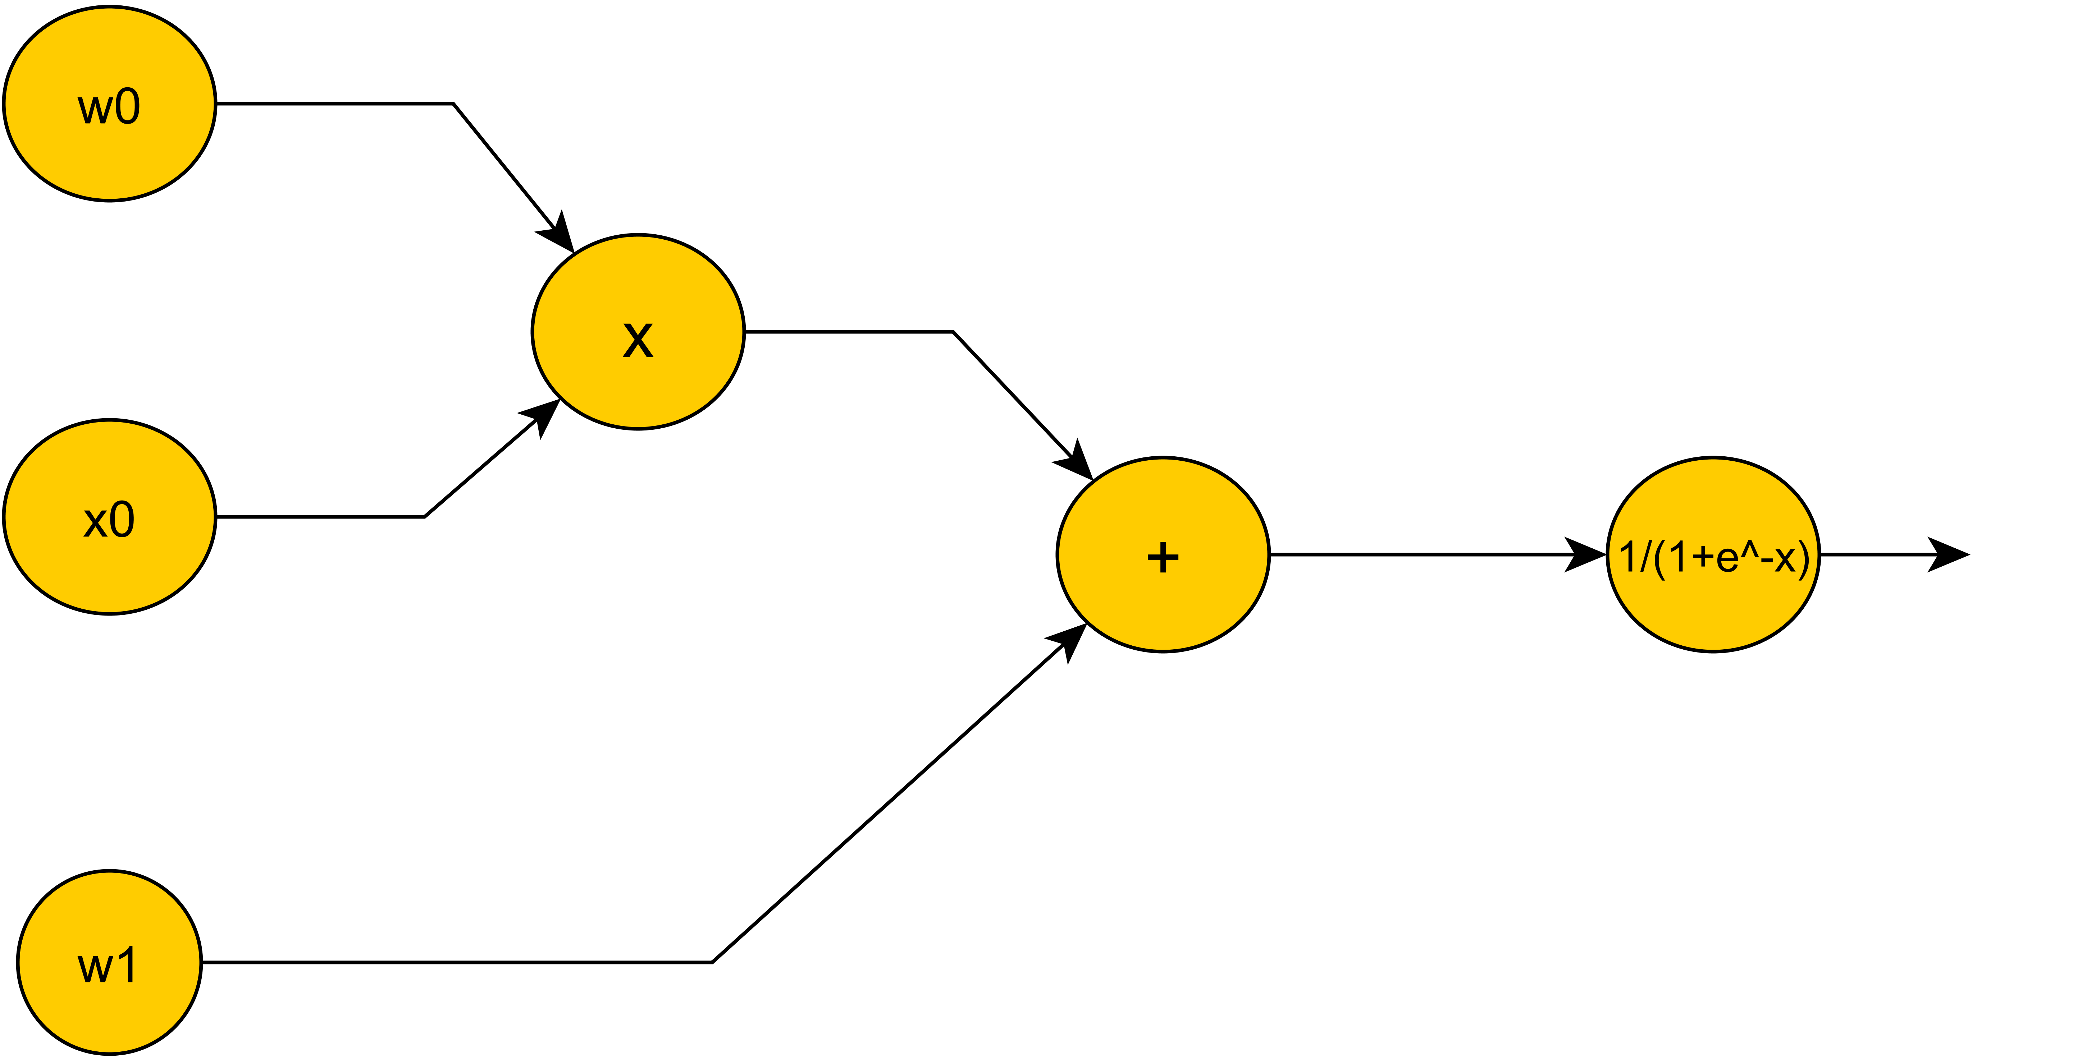

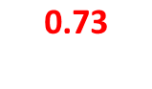
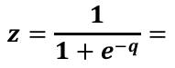
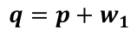
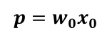
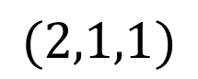

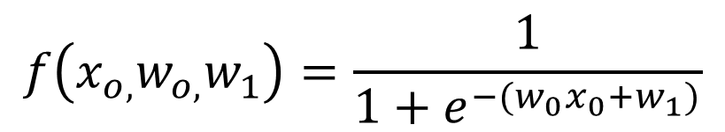
Gradient Computations based on Computational Graphs
$$f\left(x_{o,}w_{o,}w_{1}\right)=\frac{1}{1+e^{−(w_{0}x_{0}+w_{1})}}$$
Gradient of
at
$$(2,1,1)$$
2
$$p=w_{0}x_{0}$$
$$2$$
1
$$q=p+w_{1}$$
$$1$$
$$z=\frac{1}{1+e^{−q}}=$$
$$\text{0.73}$$
-1
Forward Propagation

Slide 32
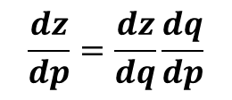

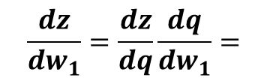
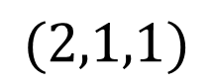
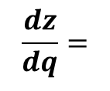
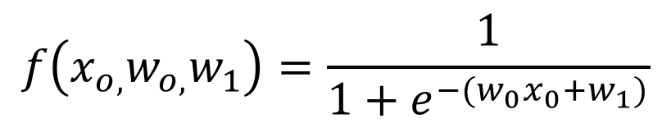

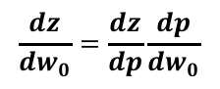
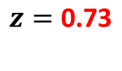
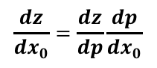
Gradient Computations based on Computational Graphs
$$f\left(x_{o,}w_{o,}w_{1}\right)=\frac{1}{1+e^{−(w_{0}x_{0}+w_{1})}}$$
Gradient of
at
$$(2,1,1)$$
2
0.196
Main Idea: Calculate global gradients using chain rule on local gradients
$$\frac{dz}{dw_{0}}=\frac{dz}{dp}\frac{dp}{dw_{0}}$$
$$p=2$$
0.196
1
$$\frac{dz}{dp}=\frac{dz}{dq}\frac{dq}{dp}$$
$$q=1$$
0.392
$$\frac{dz}{dq}=$$
$$z=\text{0.73}$$
$$\frac{dz}{dx_{0}}=\frac{dz}{dp}\frac{dp}{dx_{0}}$$
0.196
-1
$$\frac{dz}{dw_{1}}=\frac{dz}{dq}\frac{dq}{dw_{1}}=$$
0.196
Backward Propagation

